Slide 1
Deep Learning - Basics
By
Bagavathy Priya N

Slide 2
Agenda
Introduction
Why DL over ML ?
Architecture
Mathematical understanding
Hyper parameter tuning

Slide 3
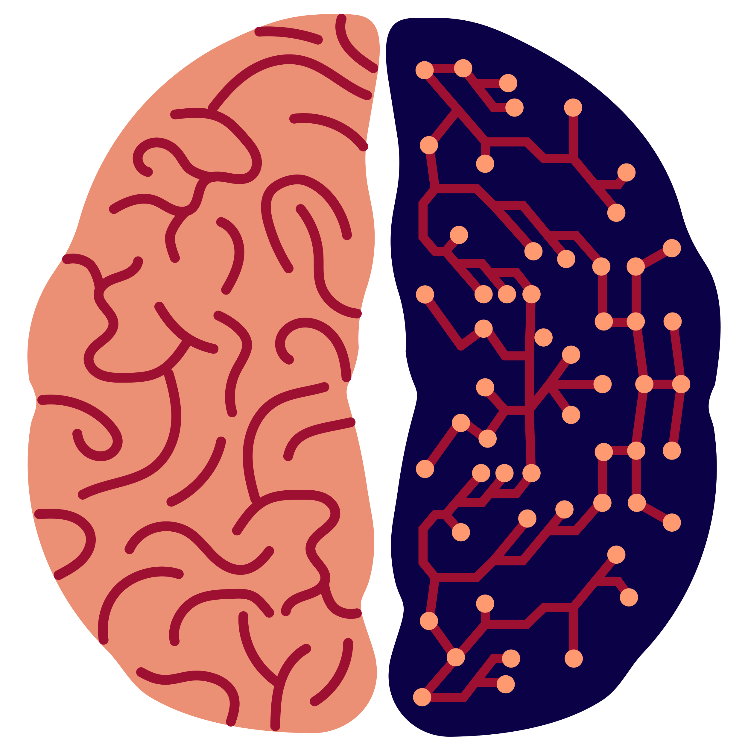
Introduction
Biological neural network => Artificial neural network

Slide 4
Why Deep learning over Machine learning ?
No need of feature engineering
Best results with unstructured data
No need of labelling of data
High quality results

Slide 5
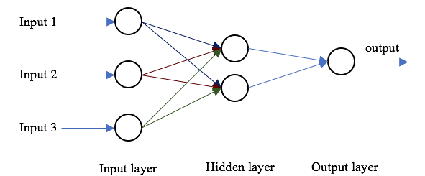
Simple architecture

Slide 6
Understanding the working
3x – y + z = 3

Slide 7
Things we did….
Taking random no’s – weights are initialised randomly
Checking LHS ~ RHS - comparing predicted value with actual value (Cost function)
If they are not equal, choosing another no’s - Updating the weights (Optimization)
Repeat the process until the correct value arrives

Slide 8
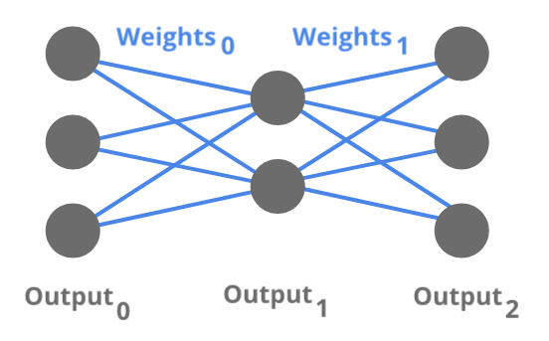

Mathematical equation

Slide 9
Activation function
The purpose of the activation function is to introduce non-linearity into the output of a neuron.
Non-linearity in neural networks simply mean that the output at any unit cannot be reproduced from a linear function of the input.
A neural network without an activation function is essentially just a linear regression model.
The activation function does the non-linear transformation to the input making it capable to learn and perform more complex tasks.
Examples: ReLU, Sigmoid, Tanh, Softmax

Slide 10
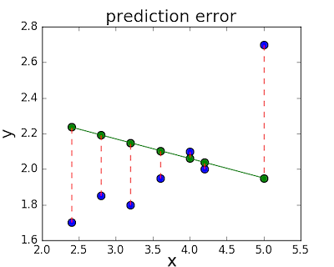
Loss function

Slide 11
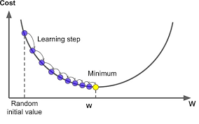
Optimization

Slide 12
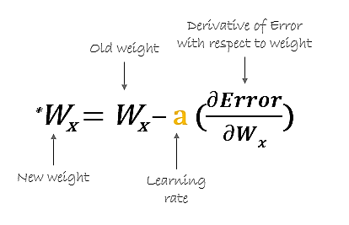
Back propagation

Slide 13
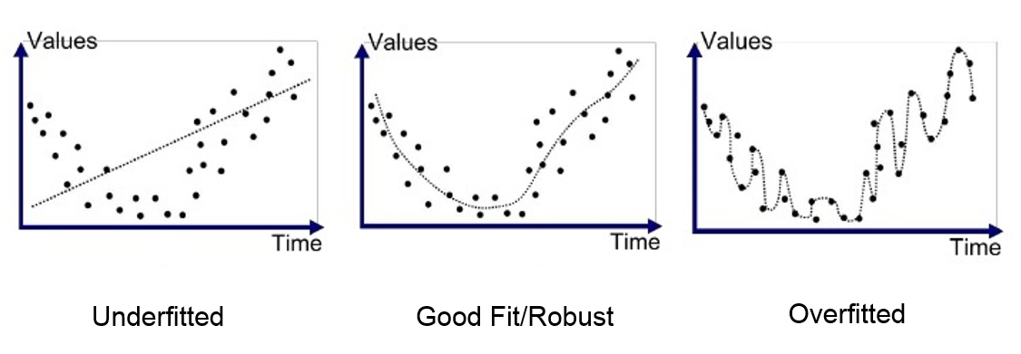
Overfitting & Underfitting

Slide 14
How to overcome ?
Overfitting
Underfitting
Early stopping
Regularization
Dropout
Ensembling
Making less complex of architecture
More data
Adding more layers
Reducing regularization
Increase the complexity of model
Adding features to training data

Slide 15
Thank you !!!!!!
Any queries ?

